Slide 1
Soap Operas in India
Ganesh Kumar Ranjan
Faculty, MJMC,
MMHA&PU

Slide 2
Before 1980s’ Hindi feature films and film based programs dominated Indian Television.
Mid 1980s domestically produced Indian language serials debuted television.
Soap operas from Britain , United States and Germany were telecasted.
British sitcoms:
-To The Manor Born
Some Mothers Do Love
Em And Sorry

Slide 3
British operas:
Bronowski’s Ascent of Man
Kenneth Clark’s Civilization
Nature documentary by David Attenborough
American operas
I Love Lucy
Startrek
German Detective
The Fox

Slide 4
Mexican Telenovela inspired Indian Television Soap operas
Ven Conmingo(Come With Me) promoting family planning.
Peruvian Telenova ‘Simlimente Maria’ a story of migrant girl who become rich by sewing(sponsored by Singer)

Slide 5
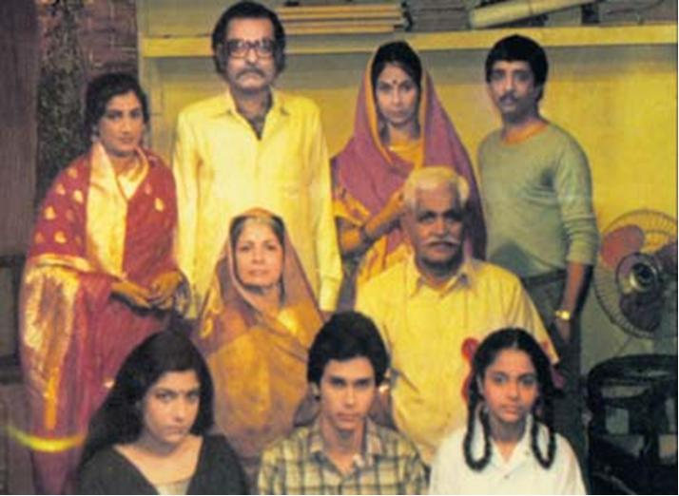
Humlog
S.S.Gill
Shobhana Doctor
P Kumar
Satish Garg
Manohar Shyam Joshi
Sponsored By Maggi
Story-Ups and downs in the life of a North Indian lower middle class joint family.
Ashok Kumar wound up each episode with authoritative exhortation on ‘the message’.
Episode 154-156 from July 7 1884 to December 17 1985

Slide 6
Hamlog was a phenomenal success and brought many fold increase in the Doordarshan revenue.
New serials acme off within quick succession.
Some popular:
Khandaan, Buniyad,ye Jo Hai Jindagi,chehere, Humrahi, Aurat, Shanti, Swabhiman, Ithihaas…
After the advent of cable television, soap operas see increase in number, Ekta Kapoor started a new trend in soap operas genre with ‘K-series’ like: Kyunki Saas Bhi Kabhi Bahu Thi, Kahani Ghar Ghar Ki, Kahin To Hoga, Kasauti Zindagi Ki

Slide 7
Thank You

